Slide 1
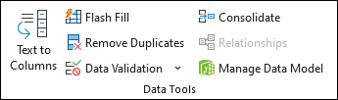
DATA VALIDATION
Understanding Data Validation in Excel
How to Use Data Validation in Excel?
Advanced Data Validation Techniques
Conclusion

Slide 2
WHAT IS DATA VALIDATION?
Data validation is a feature available in Microsoft Excel. It allows you to do the following:
Make a list of the entries that restricts the values allowed in a cell and also can set custom rules. Create a prompt message explaining the kind of data allowed in a cell. Create messages that appear when incorrect data has been entered.
Data validation is implemented to restrict entering wrong data.
The data which are already entered are plotted and removed.

Slide 3
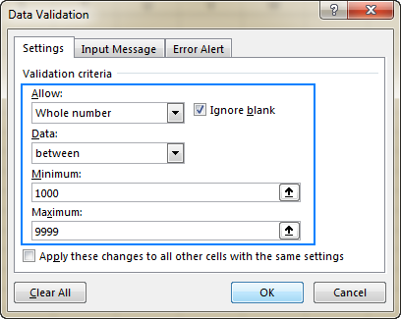
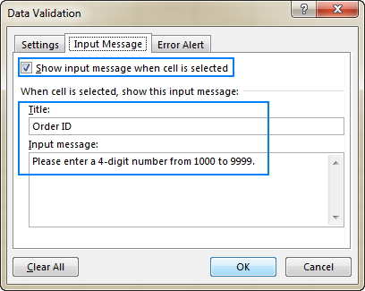
How to use Data Validation in Excel?
1. Select one or more cells to validate.
2. On the Data tab, in the Data tools group, click Data Validation.
3. On the Setting tab, in the Allow box, select List.
Whole Number- to restrict the cell to accept only whole numbers.
Decimal- to restrict the cell to accept only decimal numbers.
List- to pick data from the drop-down list.
Date- to restrict the cell to accept only date.
Time- to restrict the cell to accept only time.
Text Length- to restrict the length of the selected text.
Custom- for custom formula.
4. Then choose the required option from Data.
5. Set the other required values based on what you chose for Allow and
Data.
Input Message- customize a message users will see when entering data.

Slide 4
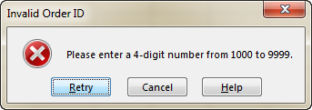
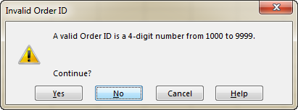
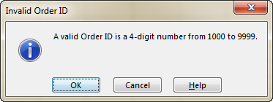
Error Alert- customize the error message and to choose a Style. Alert Types :
Stop – The strictest alert type that prevents users from entering
invalid data.
You click Retry to type a different value or Cancel to remove the entry.
Warning - warns users that the data is invalid, but does not prevent
entering it.
You click Yes to input the invalid entry. No to edit it, or Cancel to
remove the entry.
Information – The most permissive alert type that only informs users
about an invalid data entry.
You click OK to enter the invalid value or Cancel to remove it
from the cell.
6. Select OK.

Slide 5
Advanced Data Validation Techniques:
Using Drop-down Lists- One of the most common data validation uses is creating a drop-down list. Select ‘List ‘ in the Allow box, and then enter the range of values or type them directly separated by commas.
Prepare your data: Organize your data in a structured manner, typically using separate tables or range.
Define named range: Assign named ranges to each data range that will be used in the dependent drop-down lists.
Create the first drop-down list: Select the cell where you want the first drop-down list to appear. Go to the Data tab and click Data Validation. In the Setting tab, choose “List” under Allow.
Create the dependent drop-down list: Select the cell where you want the dependent drop-down list to appear. Repeat the Data Validation process. In the Setting tab, choose “Custom” under Allow. Enter the following formula in the Formula box: =INDIRECT(first drop-down list cell)
Click OK.

Slide 6
Conclusion:
Data validation is a fundamental feature in Excel that enhances the integrity and reliability of data. By understanding how to implement and utilize data validation effectively, you can prevent errors, save time, and improve the overall efficiency of your data management process.
THANK YOU

